Slide 1
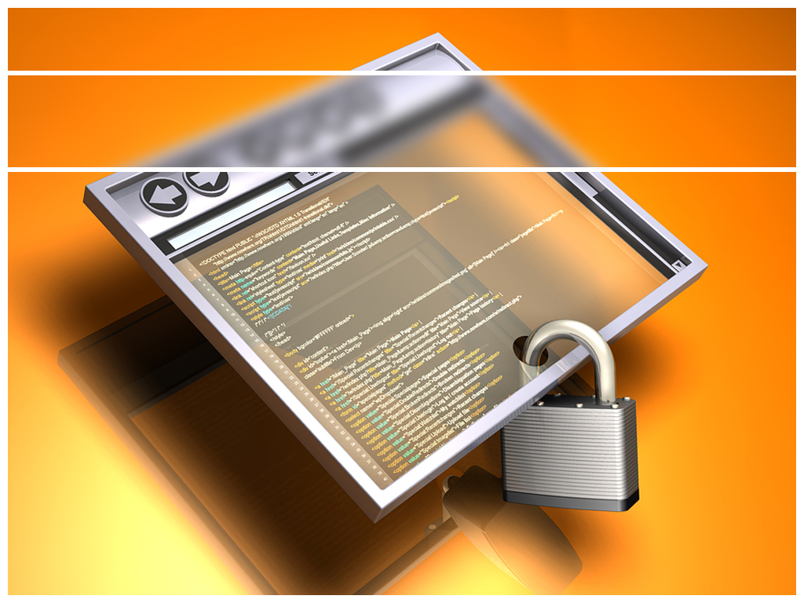
Software Processes
Lecture 3

Slide 2
Topics covered
Software process models
Process activities, advantage and disadvantage
Coping with change
The Rational Unified Process
An example of a modern software process.

Slide 3
Software Process Models
A structured set of activities required to develop a software system.
Many different software processes but all involve:
Specification – defining what the system should do;
Design and implementation – defining the organization of the system and implementing the system;
Validation – checking that it does what the customer wants;
Evolution – changing the system in response to changing customer needs.

Slide 4
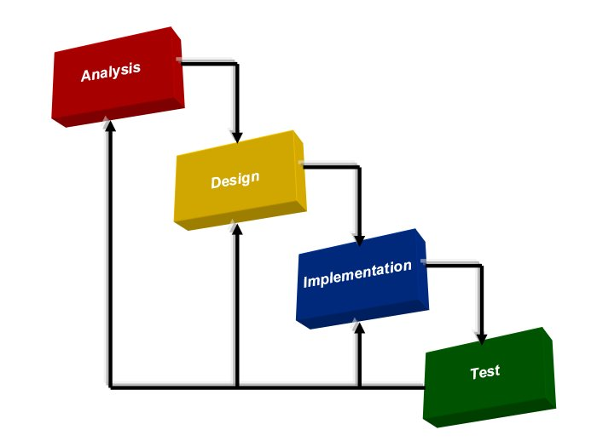
The waterfall model

Slide 5
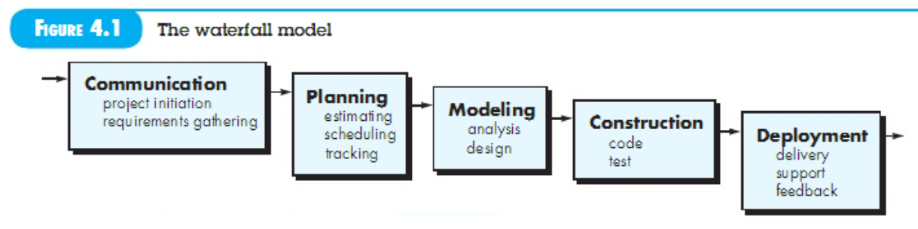

Slide 6
The waterfall model
Main characteristics:
Also called classic software life cycle or sequential model
Process activities (phases/stages) are clearly separated

Slide 7
The waterfall model
Advantages
Organized approach, provides robust separation of phases
Reflects common engineering practice
Disadvantages:
Doesn’t cope well with changes required by the client
Development teams might wait for each other
A working version of the product is available only late
Applicability:
When requirements are well known and few changes are likely to be needed
Can be used also for parts of larger software systems

Slide 8
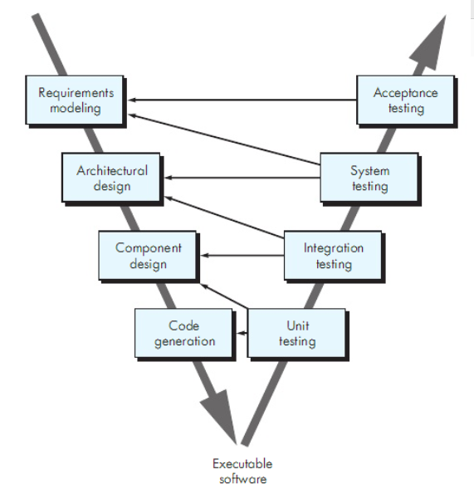
The V Model

Slide 9
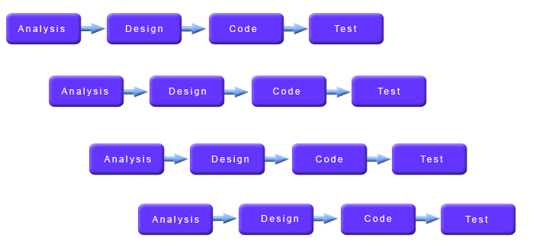
The Incremental Model

Slide 10
The Incremental Model
Main characteristics
Hybrid model that combines elements of the waterfall and evolutionary paradigms
The specification, design, and implementation phases are broken in smaller increments
Advantages
Provides better support for process iteration
Reduces rework in the software construction process
Allows early delivery of parts of the system
Supports easier integration of sub-systems
Lower risk of project failure
Delivery priorities can be more easily set

Slide 11
The Incremental Model
Disadvantages
Mapping requirements to increments may not be easy
Some decisions on requirements may be delayed
Applicability:
When it is possible to deliver the system “part-by-part”

Slide 12
Evolutionary Development model
When to Use:
Tight Market Deadline
Detailed system extensions are unclear
Need frequent feedbacks

Slide 13
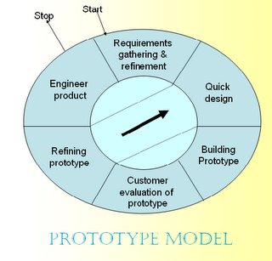
Prototyping

Slide 14
Positive Sides
Gather requirements
Quick design focusing on what will be visible to user – input & output formats
Process iterated until customer & developer satisfied
then throw away prototype and rebuild system to high quality

Slide 15
Negative Aspect
- Insufficient analysis
- Excessive development time of the prototype
- High expectations for productivity with insufficient effort

Slide 16
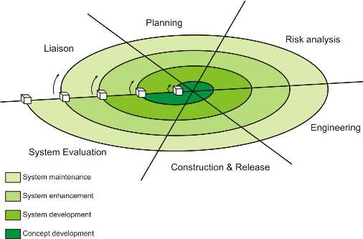
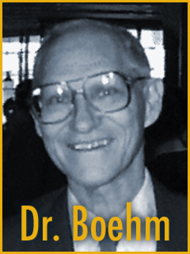
Boehm’s Spiral Model

Slide 17
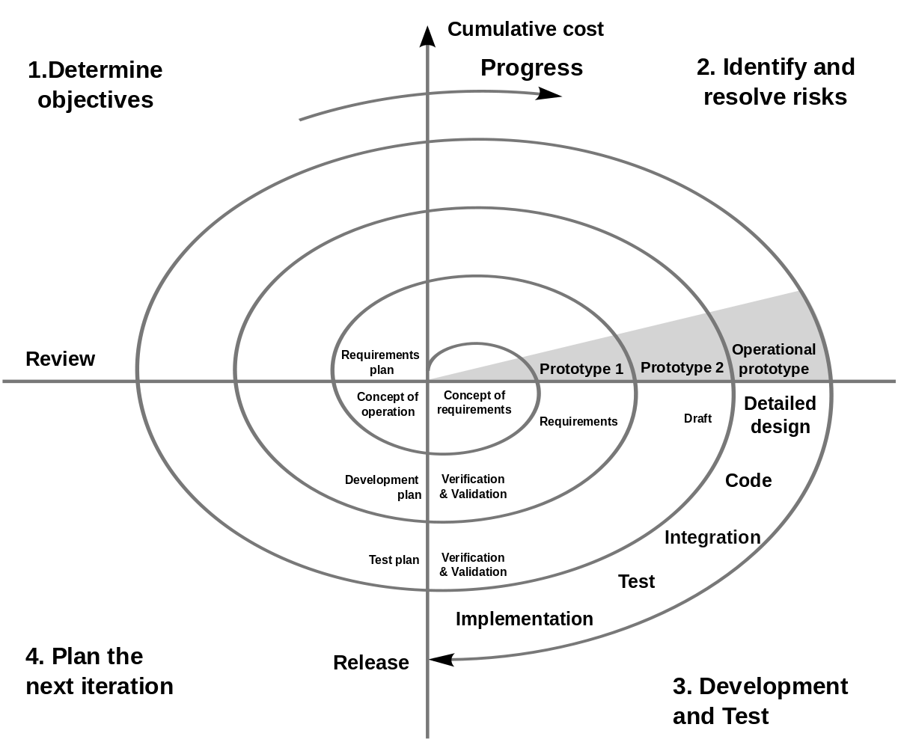

Slide 18
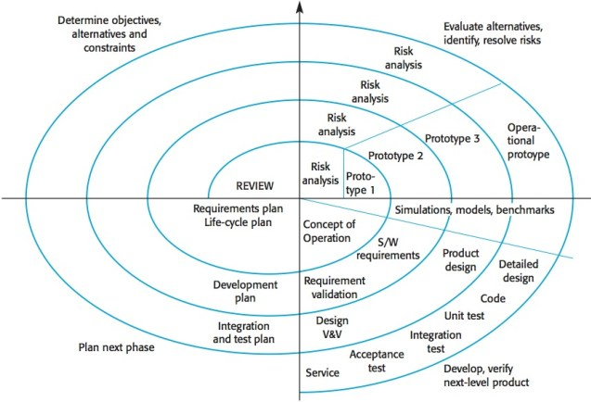
Boehm’s Spiral Model

Slide 19
Spiral model sectors
Objective setting
Specific objectives for the phase are identified.
Risk assessment and reduction
Risks are assessed and activities put in place to reduce the key risks.
Development and validation
A development model for the system is chosen
Planning
The project is reviewed and the next phase of the spiral is planned.

Slide 20
Boehm’s Spiral Model
Main characteristics
Also a hybrid model that support process iteration
The process is represented as a spiral, each loop in the spiral representing a process phase
Risk is explicitly taken into consideration

Slide 21
Boehm’s Spiral Model
Advantages
Risk reduction mechanisms are in place
Supports iteration and reflects real-world practices
Systematic approach
Disadvantages:
Requires expertise in risk evaluation and reduction
Complex, relatively difficult to follow strictly
Applicable only to large systems
Applicability
Internal development of large systems

